Slide 1
Verification of Warnings
African Regional Training on Severe Weather Forecasting and Warning Service – Workshop on Public Weather Services
Pretoria, 16th -20th November 2015

Slide 2
Outline
Discuss how we validate impact based warnings.
Discuss what information we need to validate impact based warnings.
Discuss how we get that information
Discuss the challenges
Describe a subjective assessment process used in the UK

Slide 3
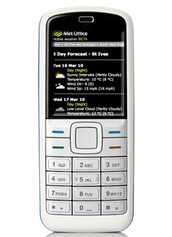
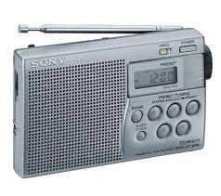
What makes an effective warning?
Easy to
understand
Variety of
access points
Help
Emergency
Responders
respond
Essential
Elements
Easy to
access
Help
Emergency
Responders
plan
Help people
decide
what to do
Change
behaviour
Effective
Notes:
A summary

Slide 4
How to we establish if a warning was effective?
Ask the users of the warning
Disaster Managers?
Public?
Check against observations
But do we have observations of impacts?
We cannot just check against meteorological observations

Slide 5
How do we get feedback from users?
Disaster managers
We can ask them directly
Info from them is reliable and proportionate.
Public
Formal surveys
General feedback via contact centre

Slide 6
Feedback channels in UK
What feedback channels do we use?
24/7 customer call centre
Twitter
Facebook
Surveys
Ask disaster managers/event debriefs

Slide 7
Customer Centre
Customer Centre staff work 24/7/365
When they receive email or call they deal with it immediately if possible
If not they send the enquiry to an expert in the Met Office
The expert sends response to Customer Centre to respond on their behalf to preserve anonymity
Feedback (complaints and compliments) captured on a feedback management system

Slide 8
Customer Centre
Target set by Met Office to resolve feedback within 28 days, with a ‘stretch’ target of 20 days
Monthly feedback report compiled for Met Office managers
This contributes to how the Met Office can work towards refining and improving products and services
April to September this year 350 complaints a month on average
Last year we refreshed the website and had an average of 694 complaints a month

Slide 9
Formal surveys
After any AMBER or RED warning (medium or high impacts expected) we survey the public and responders in the area
Ask for their satisfaction levels
Ask if they took any actions as a result of the warning.

Slide 10
Public Appreciation
90% of the public think Met Office weather warnings are useful

Slide 11
Feedback form on website

Slide 12
Check against impact observations
Where do we get such observations?
Media? Reliable?
Disaster Management teams? Too busy?
Social Media? Reliable?
WOW? Reliable?

Slide 13
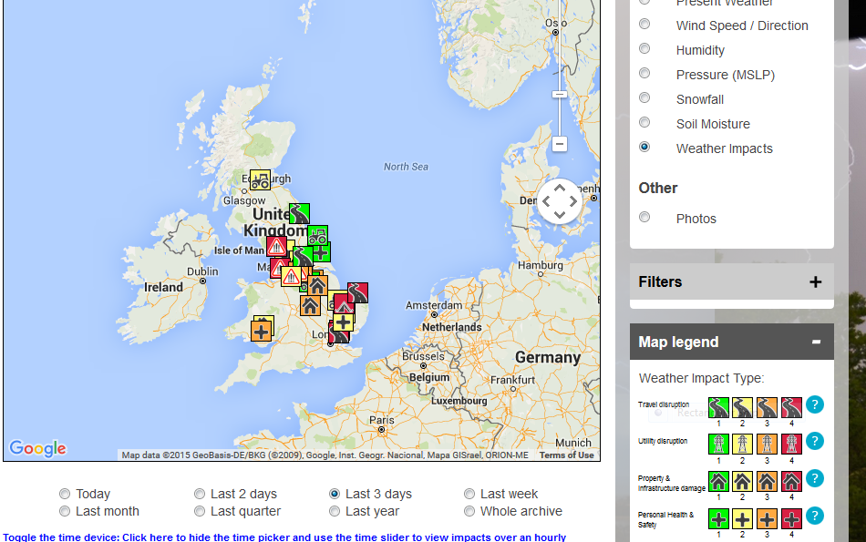
Weather Observations Website (WOW) – includes impacts option
Notes:
WOW – weather on the web
Real-time weather observations

Slide 14
What are the challenges with impact data?
Media – sensationalist!
Public – assessed by their individual circumstances
Social Media – geo tags may not be correct
Social Media – difficult to filter out appropriate information
WOW – correct time and place

Slide 15
Check against impact observations
Need to gather in as much impact information as possible.
From impact information gathered from media, responders, social media and any other sources we must:
Check the level of impacts against that highlighted in the warning matrix
Check the time and areas affected

Slide 16
Subjective Assessment
Gather impact evidence
From responders
From media
From social media
Anywhere!
Compare impacts with warning
Did they occur in the expected area?
Did they occur at the expected time
Were the impacts at the expected level – medium, high?
Was the warning issued in good time?
Are there any lessons to be learned?

Slide 17
Subjective Assessment
Assessed by an internal panel including:
Chief Forecasters
Civil Contingencies Advisors
Impact modellers
Service Managers
The basic question, “Did the warning give good advice and in good time?”
Each warning is assessed as providing guidance that is:
Excellent
Good
Poor
Very poor

Slide 18
Subjective Assessment
Assessment is then passed to the Public Weather Services Customer Group and agreed or challenged as necessary.
The process, despite being subjective, is open and transparent and, hopefully(!) consistent
PWSCG can ask us to assess events which resulted in impacts but for which no warning was issued.
Targets set:
70% of Amber and Red warnings should provide ‘Good’ or ‘Excellent’ guidance based on a two year cycle.
If the number of warnings assessed as giving “Poor Guidance exceeds 20%, an action plan for improvement will be prepared and presented to the PWSCG Secretariat

Slide 19
Summary
We must gather feedback on our services from as many sources as possible.
Social media is a valuable new tool for gathering feedback on all services.
Gathering impacts to assess impact based warnings is very difficult!
Again, social media can be a valuable new tool for indentifying impacts but the information must be treated with some caution.

Slide 20
Questions?

